Slide 1
CHE 101 Fall 2021
Lecture 3 f,g – Conversion Factors II
Overview/Topics
Units (Imperial and Metric)
Conversions
US ↔ US
US ↔ Metric
Metric ↔ Metric
Multistep Conversions
Compound Units
Squares and Cubes
Word Problems
Density
Specific Heat
Use of SN, SF, Rounding
Skills to Master
HW 3 f,g
Additional Useful Links
www.chemhaven.org/che101
Khan Academy
Google/You Tube
Read
Hein Chapter 2

Slide 2
Conversion – Compound Units
Example: Convert 65 mi/hr to km/sec
Example: Convert 5.0 gallons/sec to mL/day
Can you:
Solve Compound Units Problems
HW 3 f

Slide 3
You Try It:
Example: Convert 25 miles/gal to km/L
Example: Convert 325 tons/hr ng/min

Slide 4
Conversion – Squares and Cubes
Example: Convert 120 m² to cm²
Example: Convert 35,000 in³ to ft³
Can you:
Solve Squares and Cube Problems
HW 3 f

Slide 5
You Try It:
Example: 150 cm² to ft²
Example: Convert 3.50 x 10¹⁵ mL to mi³
Can you:
Solve Squares and Cube Problems
HW 3 f

Slide 6
Conversion – General Rules and Idea’s
Anything with 2+ units is a CF
Question → Answer
List any possible CF’s
Try
If you fail, try again!

Slide 7
Conversion – Word Problems
Example: A person driving a brand new Tesla drives 75 mi/hr. If the person drives from Rangely to Denver (a distance of 500 miles) how many hours will it take him to get there?
Example: A person driving a brand new Tesla drives 75 mi/hr. If the person robs a bank and then drives for 450 minutes how many miles away will he be?
Can you:
Solve word problems
HW 3 g

Slide 8
You Try It:
Example: A horse can haul 50.0 lbs of gear up a mountain. If you need to move 1200 kg of gear up a mountain how many horses will you need?
Can you:
Solve Word Problems
HW 3 g

Slide 9
You Try It:
Example: You work for a zoo and have decided you want to trade an elephant for some kangaroo’s but will need to do several trades to do this. You can trade 12 apes for 5 snakes, 1 elephant for 9 emu’s, 2 emu’s for 5 koala’s, 3 koala’s for 7 apes and 5 snakes for a kangaroo. How many kangaroo’s can you get if you trade 2 elephants.
Can you:
Solve Word Problems
HW 3 g

Slide 10
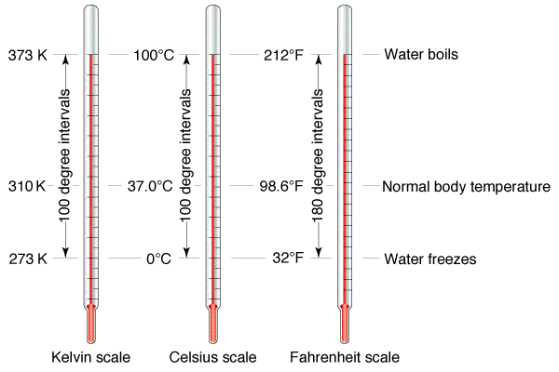
Conversion – Temperature
Slightly different than other units because °F and °C define zero differently and the size of a degree is different.
Linear relationship so we can use an equation to convert between them.
°C and K same sized unit, zero is defined differently
°F = 1.8(°C) + 32
Can you:
Solve Temperature Problems
Lab 3 Temperature

