Slide 1
CHE 101 Fall 2021
Lecture 3a – Measurements
Overview/Topics
3 parts of a measurements
Scientific Notation (SN)
Significant Figures (SF)
Exact Numbers
Multiplication and Division (M/D)
Addition and Subtraction (A/S)
Skills to Master
Determine # of SF in a measurement
Write a given number with the correct number of SF
Convert between Decimal # ↔ SN
Rounding
M/D and A/S with SF
Additional Useful Links
www.chemhaven.org/che101
Khan Academy
Google/You Tube
Read
Hein Chapter 2

Slide 2
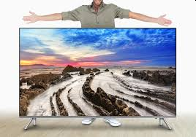
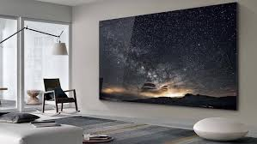
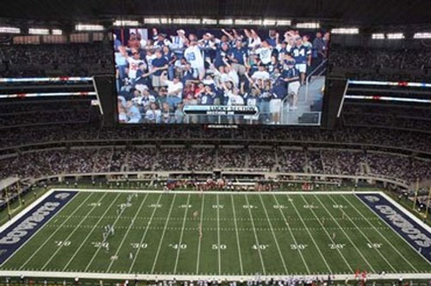
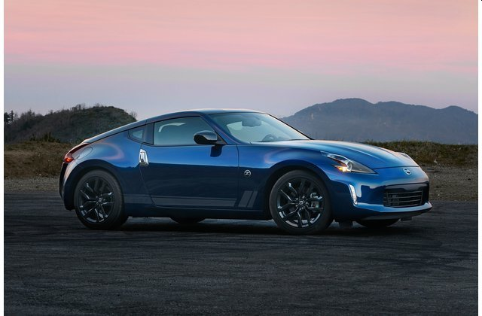
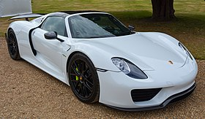
Why are numbers so important in Science (Chemistry)?
Go buy a “big” TV
Which car is “faster”?
0-60 in 5.5 sec
0-60 in 2.1 sec
Which box is colored red?
Chapter 1.4
“Measurements provide much of the information that informs the hypotheses, theories, and laws describing the behavior of matter and energy … in chemistry”
a
b
c

Slide 3
Scientific Notation
How to represent very small and very large numbers in a compact form
# atoms in 1 mole:
Mass of an electron:

Slide 4
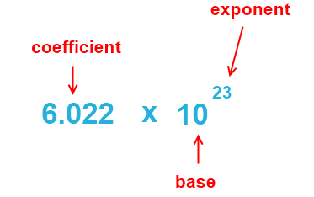
Rules for SN
Number of places the decimal point is moved
Coefficient must be 10 > # ≥ 1
+ = large number
- = small number
+ = left
- = right
or
Alternative Formats
6.022e+23
6.022e⁺²³

Slide 5
Ex. 1
Convert 330,251 to SN
Ex. 2
Convert 0.000 000 562 4 to SN
Ex. 3
Convert 2.508 x 10⁻⁴ to a Decimal
Ex. 4
Convert 1.85 x 10⁺⁵ to a Decimal
Can you:
Convert Decimal to SN ?
Convert SN to Decimal ?

Slide 6
Ex. 1
Convert 330,251 to SN
Ex. 2
Convert 0.000 000 560 to SN
3.30251 x 10⁵
5.60 x 10⁻⁷
Ex. 3
Convert 2.508 x 10⁻⁴ to a Decimal
Ex. 4
Convert 1.85 x 10⁺⁵ to a Decimal
0.000 2508
185,000
Can you:
Did you double check big/small?

Slide 7
A few more examples…

Slide 8
Rounding Numbers - KISS
≥ 5 round up
< 5 round down (stay the same)
Big Numbers – replace dropped numbers with zero
Small Numbers – drop all numbers after rounded number
Ex 1: 58.54 rounds to 58.5
58.55 rounds to 58.6
Ex 2: 0.00589 rounds to 0.0059
0.00583 rounds to 00058
Ex 3: 28.99 rounds to 29.0
0.0599 rounds to 0.060
Ex 4: Round 125.65487 to the nearest hundredths
round to 125.65
Can you:
Complete 4 types of problems

Slide 9
Rounding – the more correct version
1 2 3 4 5 6 7 8 9
Should round 5 down/up equally
If the dropped digit is 5 round to even number
25.65 would round to 25.6 (drop b/c 6 is even)
25.75 would round to 25.8 (rnd up b/c 8 is even)
DON’T USE
THIS RULE!
https://www.wyzant.com/resources/blogs/331496/rounding_rules_when_to_round_and_how_do_you_round_5_s_up_or_down

Slide 10
3 Parts of any Measurement
Significant Figures (HW 2 a,b)
Uncertainty (or Error)
150.0 ± 0.1 lb
Magnitude
Units
Next Lecture! (HW 2 c,d,e)
A correct answer always has all 3 parts!

Slide 11
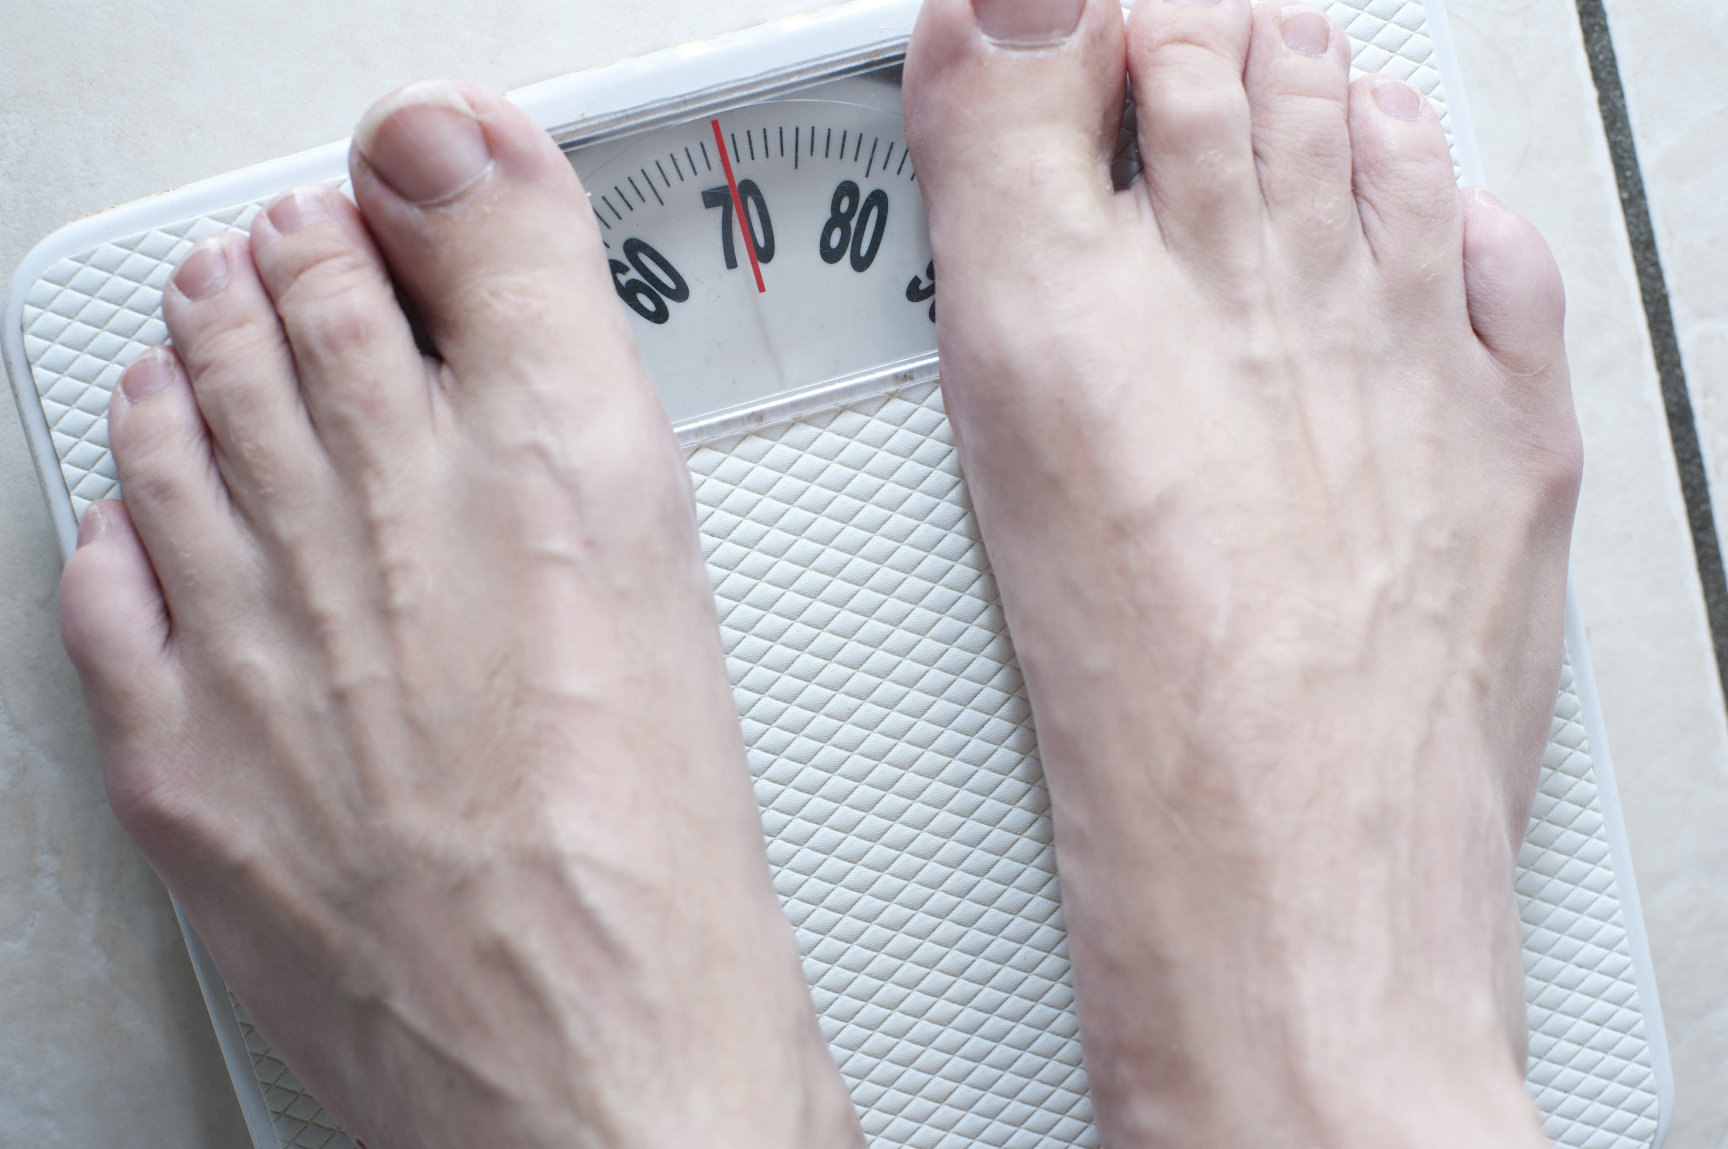
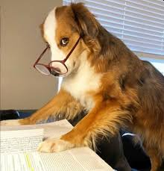
Making Measurements in Science
All measurements are experimental and contain uncertainty
Always estimate the last digit
Significant Figures (SF) indicate uncertainty
Certain Digit
Uncertain Digit
Guessing a dog’s weight: 70 lbs ± 10 lbs
1 SF
Using a Scale: 71. lbs ± 1 lbs
2 SF
Using a better Scale: 71.5 lbs ± 0.1 lbs
3 SF
Using the best Scale: 71.526 lbs ± 0.001 lbs
5 SF

Slide 12
5 Rules for Significant Figures
A measure of the uncertainty in a measurement (an alternative to ± )
All non-zero digits = SF
Captive Zero’s (between SF) = SF
Zero at the end with a decimal point = SF
Zero at the beginning ≠ SF
Zero at the end without a decimal = ambiguous (≠ SF)
Trapped/Sandwiched
Trailing
Leading
Trailing

Slide 13
Ex 1: 258.05
Ex 5: 200
Ex 2: 0.000589
Ex 6: 200.
Ex 3: 98.0560
Ex 7: 200.00
Ex 4: 0.008900
Can you:
Can you apply all 5 rules?
Visit www.chemhaven.org/che101 for more practice

Slide 14
Ex 1: 258.05
Ex 5: 200
5 SF (zero in middle counts)
1 SF (zero at end w/o
decimal do not count)
Ex 2: 0.000589
Ex 6: 200.
3 SF (zero in front d/n count)
3 SF (zero at end with
decimal counts)
Ex 3: 98.0560
Ex 7: 200.00
6 SF (zero at end with decimal count)
5 SF (trapped zero’s count and zero at end with decimal counts)
Ex 4: 0.008900
4 SF (zero in front does not count,
zero at end with decimal count)
Can you:
Can you apply all 5 rules?
Visit www.chemhaven.org/che101 for more practice

Slide 15
SF + SN + Rounding
Ex 1: Round 25.689 to 3 SF
Ex 5: 6.895 x 10⁻¹⁵ to 3 SF
Ex 2: Round 0.0005842 to 2 SF
Ex 6: 3000 to 4 SF
Ex 3: Round 25.00589 to 4 SF
Ex 7: 3000 to 2 SF
Ex 4: Round 3.480 x 10⁵ to 2 SF
Can you:
Can you combine ALL the rules?
Visit www.chemhaven.org/che101 for more practice

Slide 16
SF + SN + Rounding
Ex 1: Round 25.689 to 3 SF
Ex 5: 6.895 x 10⁻¹⁵ to 3 SF
25.7
6.90 x 10⁻¹⁵
Ex 2: Round 0.0005842 to 2 SF
Ex 6: 3000 to 4 SF
0.00058
3000.
Ex 3: Round 25.00589 to 4 SF
Ex 7: 3000 to 2 SF
25.01
3.0 x 10⁺³
Ex 4: Round 3.480 x 10⁵ to 2 SF
3.5 x 10⁵
Can you:
Can you combine ALL the rules?
Visit www.chemhaven.org/che101 for more practice

Slide 17
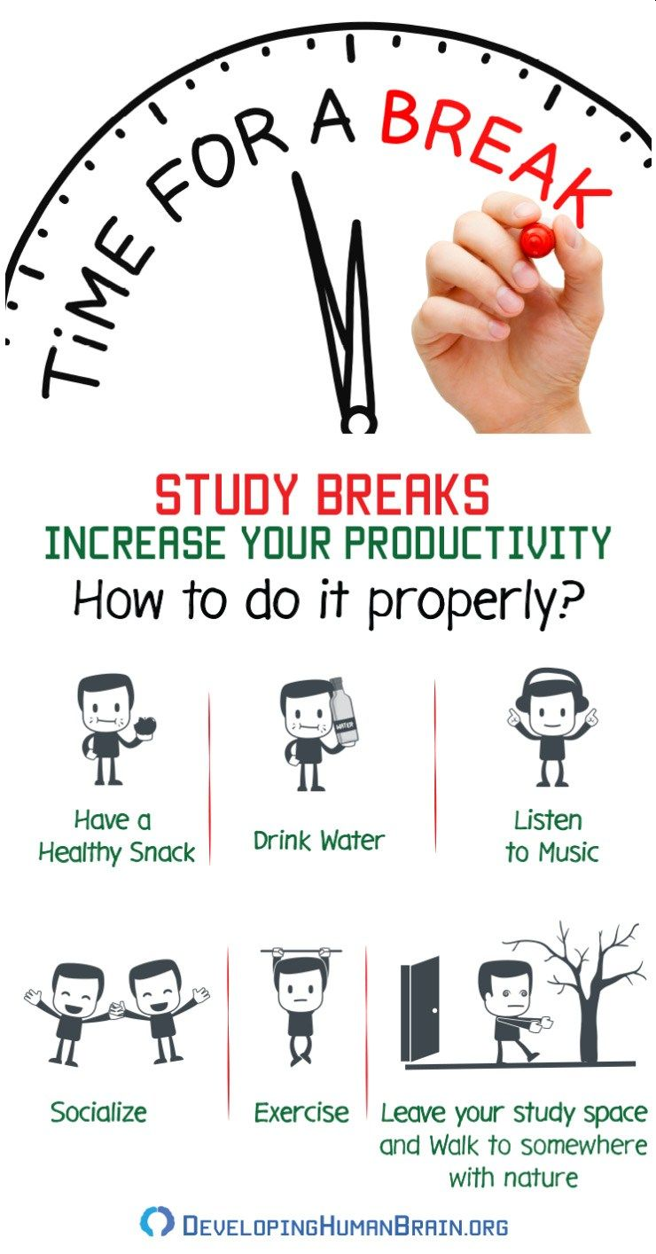
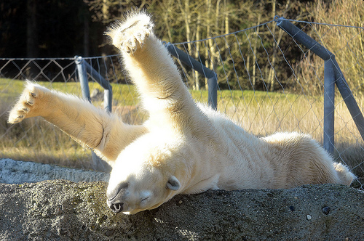

Slide 18
Multiplication and Division with SF (M/D)
Round the result to the number of SF as
the number with the least number of SF
Ex 1: (25.480)(26.3)
Ex 3: $\frac{2.950 ×{10}^{5}}{280}$
Ex 2: (3.8 x 10⁻⁸)(2254.8)
Ex 4: $\frac{10.00}{5.00}$
Visit www.chemhaven.org/che101 for more practice or watch Khan Academy
Can you:
Can you M/D with SF?

Slide 19
Multiplication and Division with SF (M/D)
Round the result to the number of SF as
the number with the least number of SF
Ex 1: (25.480)(26.3)
Ex 3: $\frac{2.950 ×{10}^{5}}{280}$
670.124 round to 3 SF
670.
1053.571429 round to 2 SF 1100 or 1.1 x 10³
Ex 2: (3.8 x 10⁻⁸)(2254.8)
Ex 4: $\frac{10.00}{5.00}$
8.56824 x 10⁻⁵ round to 2 SF
8.6 x 10⁻⁵
2 but you need 3 SF so add zero’s
2.00
Visit www.chemhaven.org/che101 for more practice or watch Khan Academy
Can you:
Can you M/D with SF?

Slide 20
Addition and Subtraction with SF (A/S)
Round the result to the least precise place value (left most)
or
Round at the last significant digit
or
Round to the fewest decimals
Ex 2:
25,000
Ex 1:
25.895
-
+
8.5
1,555
34.395
23,445
34.4
23,000
*not least SF
Visit www.chemhaven.org/che101 for more practice or watch Khan Academy
Can you:
Can you A/S with SF?

Slide 21
Extra Practice
Ex 1:
1.2
Ex 3:
15,325
+
15.25
-
1,200
Ex 4:
3.5 x 10⁻⁴
Ex 2:
0.0031
-
+
0.002538
1.23 x 10⁻⁵
Can you:
Can you combine ALL the rules?

Slide 22
Extra Practice
Ex 1:
1.2
Ex 3:
15,325
+
15.25
-
1,200
16.45
14,125
16.5
14,000
Ex 4:
3.5 x 10⁻⁴
0.00035
Ex 2:
0.0031
-
-
+
0.002538
1.23 x 10⁻⁵
0.0000123
0.005638
0.0003377
0.0056
0.00034
Can you:
Can you combine ALL the rules?

Slide 23
Exact Numbers
Do not have uncertainty associated with them
therefore do not have SF (or are considered to have an infinite number of SF)
Counting (if its possible to count exactly)
Definitions (or Conversion Factors)
10 people in a room
It took 5 hours to finish a job
100,000 people live in Grand Junction
12 in = 1 ft
1 mile = 5280 ft
1 gallon = 3.785 L
1 gallon = 3.78541178 L
KISS – we will assume Conversion Factors all have infinite number of SF

