Slide 1
Chemistry 101
Chapter 2
Classifications of Matter
States of Matter – solid, liquid, gas
Pure substances (Elements and Compounds) and Mixtures
Mixtures – homogeneous and heterogeneous

Slide 2
Chapter 2a
Chapter 2b
Goals
Differentiate state of matter (s,l,g) based on:
Volume
Shape
Particles
Compressibility
IMF (attractive forces)
Energy
Differentiate Elements, Compounds, Mixtures
Chemical/Physical Separable
Fixed/Variable composition
Differentiate Homo/Hetero-generous
Intensive vs Extensive Properties
Chemical vs Physical Properties
Chemical vs Physical Changes
Goals
Definitions – Element, Atom, Compound
Periodic Table Nomenclature
Alkali Metals
Alkaline Earth Metals
Transition Metals/Representative Elements
Halogens
Noble Gases
Lanthanides/Actinides
Identify Metals, Nonmetals, Metalloids (7)
Diatomics (7)
Molecular vs Ionic (7)
Basics of chemical formulas

Slide 3
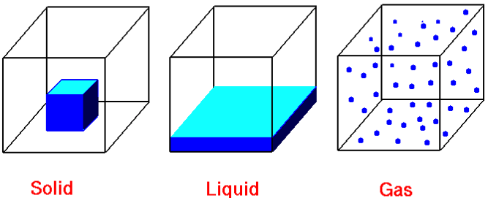
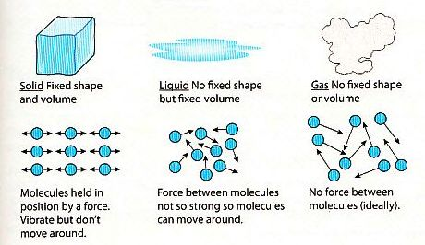
Physical States of Matter
State | Shape | Volume | Particles | Compressibility | IMF/Energy
Solid | Def. | Def. | Ridged, clinging, tightly packed | Very Low | IMF >> Energy
Liquid | Indef. | Def. | Mobile, adhering | Low | IMF ≈ Energy
Gas | Indef. | Indef. | Independent, far apart | High | IMF << Energy

Slide 4
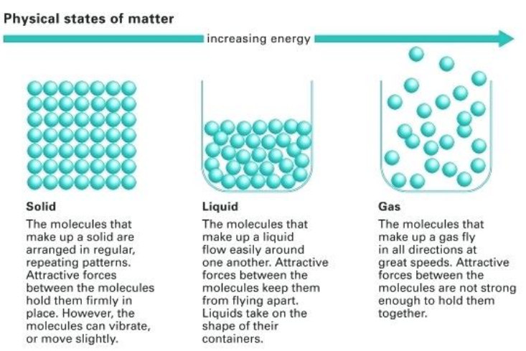

Slide 6
Pure Substance: | matter with a definite fixed composition chemically mixed together, that can not be physically separated and has the same physical and chemical properties.
Mixture: | matter containing two or more substances physically mixed together with variable composition and variable physical and chemical properties.
 | Pure Substance | Mixture
Seperable | Not Physically Separable | Physical
Composition | Fixed | Variable
P and C Properties | Same | Different

Slide 7
 | Element | Compound
Seperability | Not | Chemically
Composition | Fixed | Fixed
Number | Singular | 2 or More
Element: | Singular (fundamental), can’t be broken down. (Nuclear Chemistry)
Chemical Bond
Compound: | Two or more elements chemically combined (Ionic or Molecular)
Formed between atoms by gaining/losing electrons or sharing electrons.

Slide 8
 | Homogeneous | Heterogeneous
Phase | 1 | 2+
Appearance | Uniform | 2+ disctinct
Properties | Uniform | Different
Homogenous: | Uniform in appearance (no phase boundaries) and same properties throughout. (1 phase)
Heterogeneous: | Not Uniform in appearance (visible phase boundaries) and different properties throughout (2 phase)

Slide 9
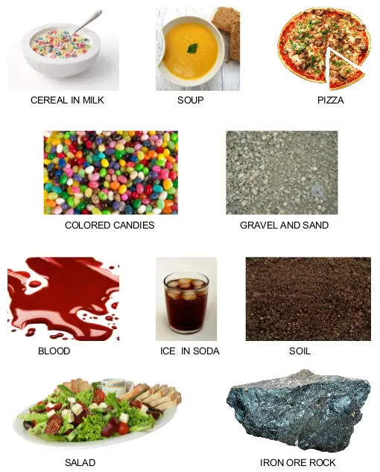
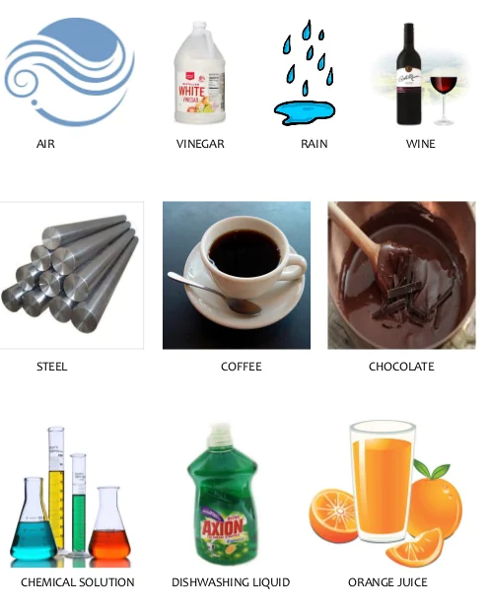
Homogeneous
Heterogeneous

Slide 10
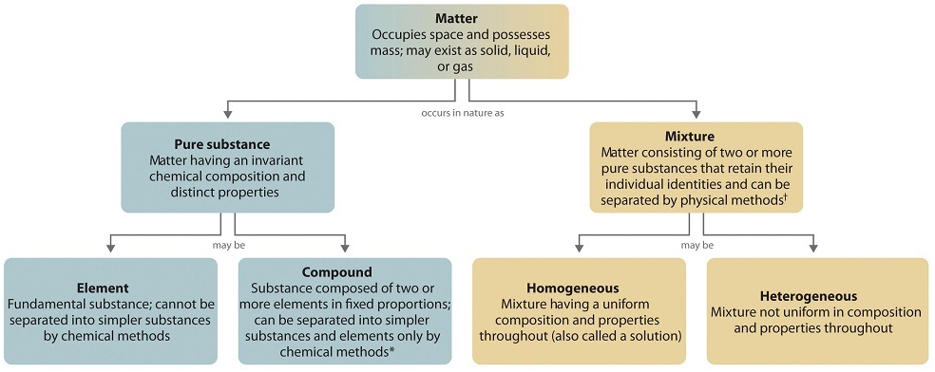
NOT Physically Separable
Physically Separable
Fixed Composition
Variable Composition
NOT Chemically Separable
Chemically Separable
Singular
Two or More
Separable by
Nuclear Reactions
Uniform Appearance
Same Properties Throughout
No Phase Boundary
NOT Uniform Appearance
Different Properties
Phase Boundary

Slide 11
Extensive Properties
Intensive Properties
Depends on the amount of matter present
Independent on the amount of matter present
Density, Temperature, Specific Heat
Mass, Volume, Heat/Energy
*Preferred types of measurements to make

Slide 12
Physical Properties
Chemical Properties
Characteristic of matter not associated with a change in its chemical composition
The change of one type of matter to another
Density, color, taste, odor, state of matter (s, l, g), hardness, melting/boiling point and electrical conductivity
Flammability, Toxicity, Acidity, Chemical Reactivity
Intermolecular
Forces (IMF)
Physical Change
Chemical Change
Chemical Bonds
Change in state of or property without any change in its chemical structure
Change produces a new type of matter (different structure)
Melting/Freezing/Evaporation/Condensation, Dissolving, Magnetization
Rust, Combustion, Cooking, Digesting, Rotting
*Nondestructive and Reversible
*Destructive and Irreversible
Break chemical bonds

Slide 13
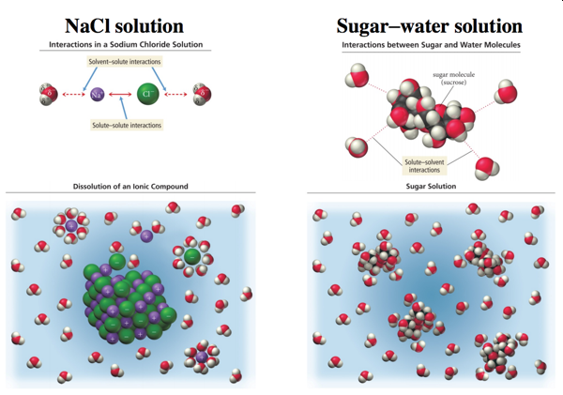
A harder example…

Slide 14
Chemistry 101
Chapter 2b
Classifications of Matter
Elements and Compounds
Periodic Table
States of Elements, Diatomic and Metalloids
Ionic and Covalent/Molecular Compounds
Chemical Symbols

Slide 15
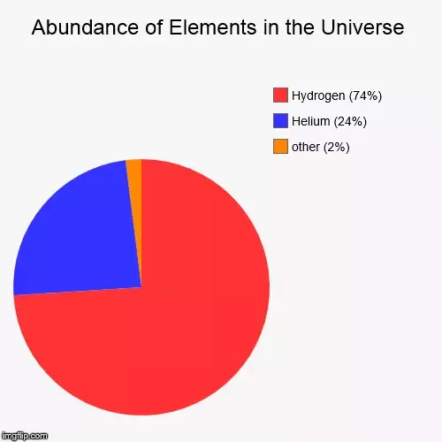
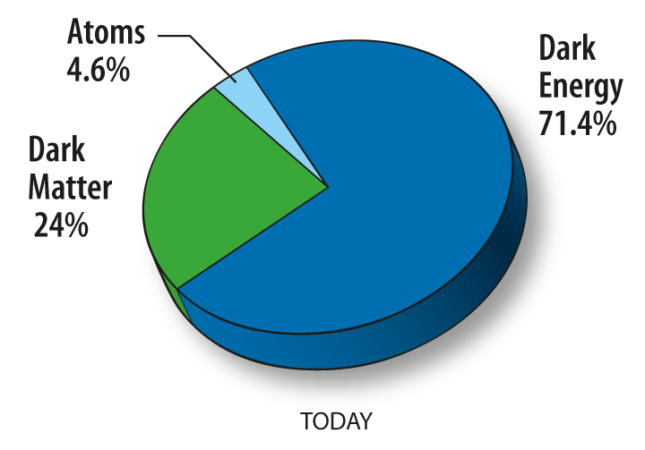
What is the Universe Made up of?

Slide 16
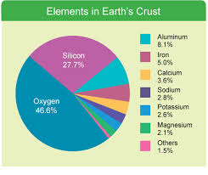
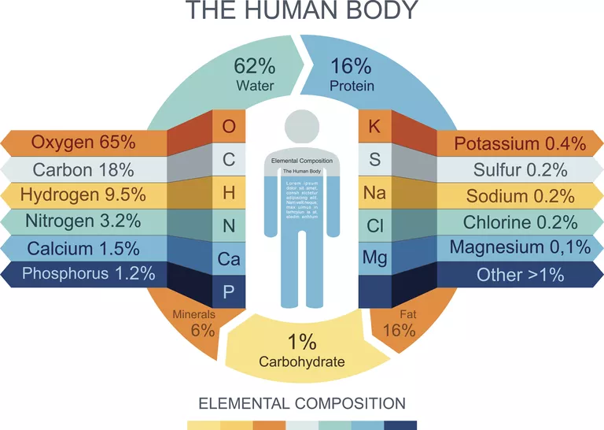
What is the World made up of?
What are Humans made up of?

Slide 17
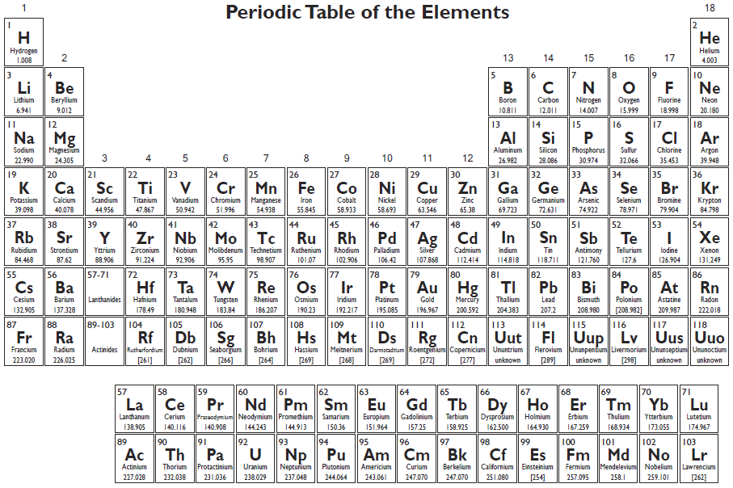
Elements: Fundamental substance that can not be broken down into simpler substance
Everything is made up of E
Alphabet/Numbers
Symbols (1 or 2 letters)
Capitalize 1st,
Lower case 2nd
Taken from greek/latin

Slide 18
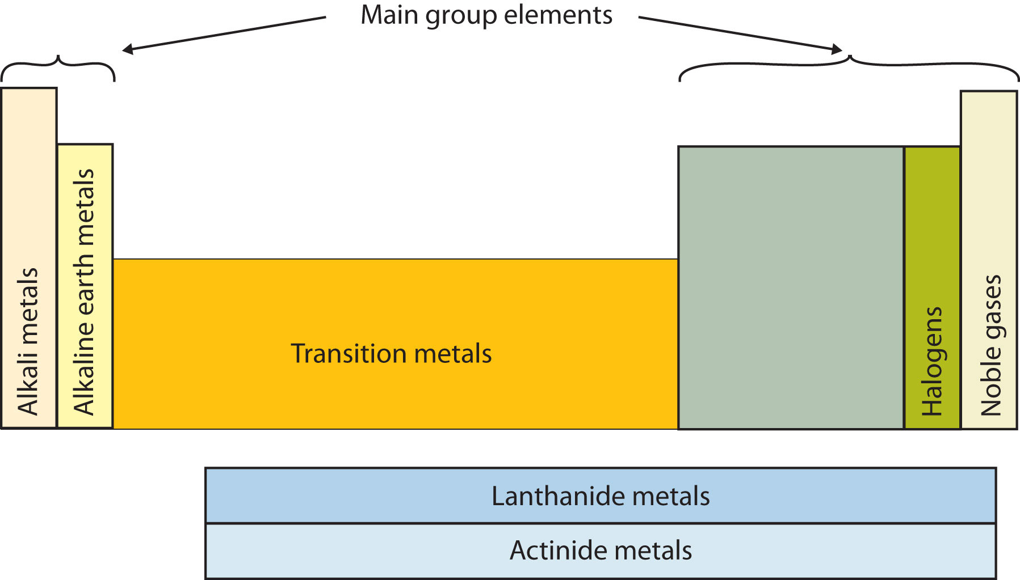
Know the following:
Alkali Metals
Alkaline Earth Metals
Transition Metals
Actinides
Lanthanides
Halogens
Noble Gases
Representative/Main group elements

Slide 19
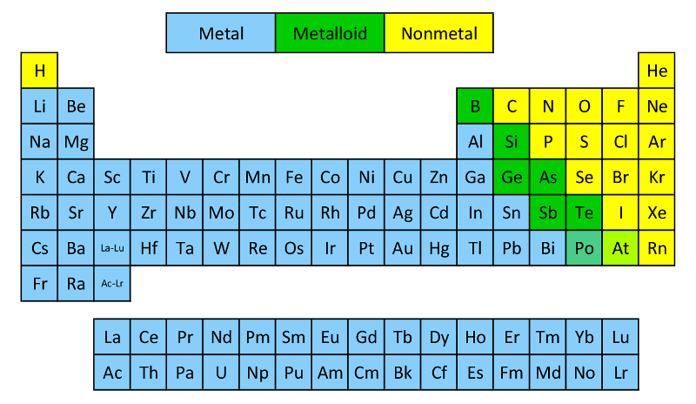
Know the following:
Metalloids (7*) – B, Si, Ge, As, Sb, Te, Po/At
Metals (left)
Non-metals (right)
 | Metals | Nonmetals
State | Solid | Solid/Liquid/Gas
Melting Point | High | Low
Density | High | Low
Appearance | High luster | Not lusterous
Conduction (heat/elect) | Good | Poor
Form | Cations (lose electrons) | Anions (gain electrons)

Slide 20
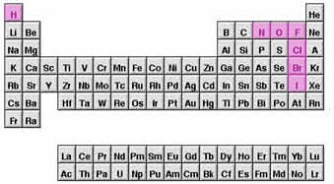
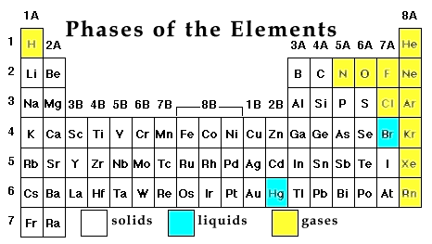
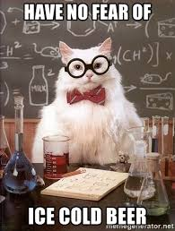
Know the following:
States of Elements
Gas: H, N, O, F, Cl + noble gases (11)
Liquid: Br, Hg (2)
Solids: all the rest
Diatomic: H, N, O, F, Cl, Br, I (7)

Slide 21
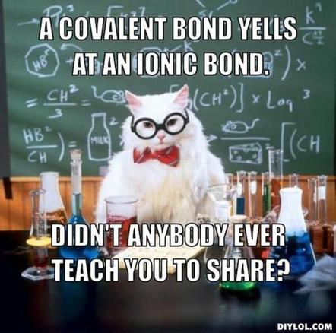
Compound: 2 or more E, chemically combined (bonded) in definite proportions
 | Ionic | Covalent or Molecular
Formed by | Gain/lose electrons | Share electrons
Between | m/nm | nm/nm
Bond Strength | High | Low
Melting Point | High | Low
Solubility | High | Low
Conductivity | High | Low
Structure | Lattice | Discrete Molecules

Slide 22
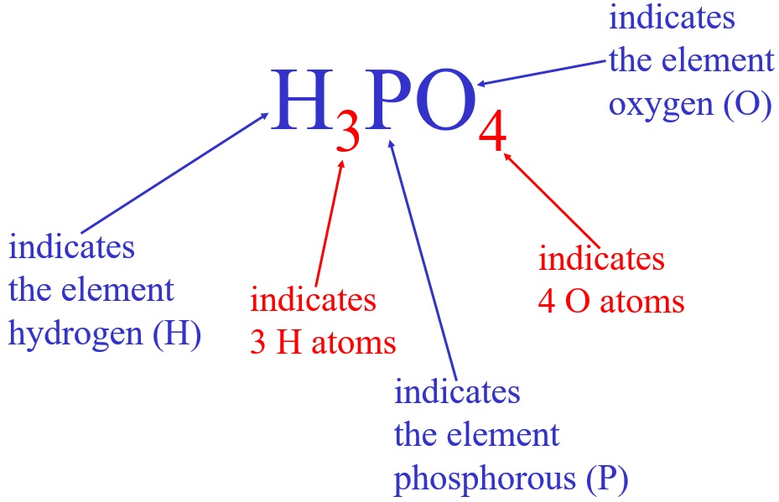
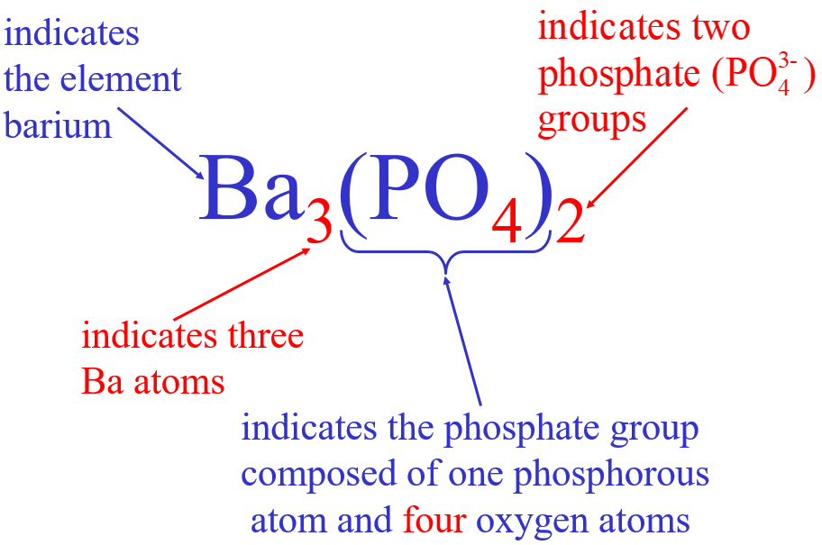
Chemical Formulas
Symbols indicate E present
Subscripts = number of atoms
( ) = groups of atoms
# in front = # of molecules

Slide 23
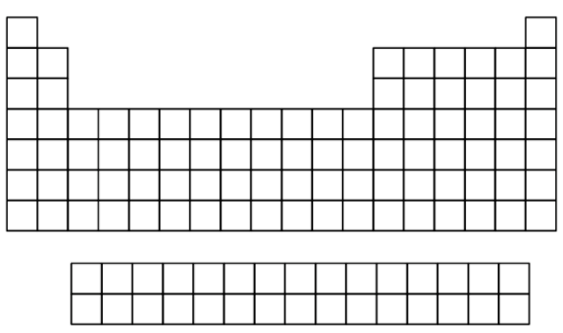

Slide 25
