Slide 1
CHE 101 Fall 2021
Lecture 11a – Equilibrium and Reaction Rates
Overview/Topics
Equilibrium Reactions
Le Chatelier’s Principle
Add R or P
Remove R or P
Temperature
Pressure and Volume
Reaction Rates
Concentration (Collision)
Temperature
Catalysts
Skills to Master
HW 11 a
Read
Chapter 16.1-16.8

Slide 2
Part I
Equilibrium and Le Chatelier’s Principle

Slide 3
Reversible Reactions
Reactions that go to completion
Reactions that are reversible
A + B → C + D
A + B ↔ C + D
0%
100%
25%
75%
60%
40%
Other Reaction
“arrows”
↔

Slide 4
Dynamic Equilibrium
Reactants → Products
Reactants ← Products
Rate of Forward
Reaction
Rate of Reverse
Reaction
=
Amount of
Reactants
≠
Amount of
Reactants
A + B ↔ C + D
25%
75%
60%
40%

Slide 5
Le Chatelier’s Principle
If a stress is applied to a system in equilibrium, the system will respond in such a way to relieve the stress and restore equilibrium under a new set of conditions
Relieve means:
System shift the reaction to undo the stress
*never fully removes stress
“2 or 4” Stress’s ?
Add more R/P
Remove R/P
Temperature (Energy)
Pressure/Volume
New set of conditions:
The relative amounts of R and P is altered
*never returns to original conditions

Slide 6
Example:
A + B ↔ C + D
Stress Applied | Direction Reaction Shifts | [A] | [B] | [C] | [D]
Add A

Slide 7
A + B ↔ C + D
Original Equilibrium
2 A’s 2 B’s
2 C’s 2 D’’s
New/Different Equilibrium
5 A’s = 3 C’s
1 B = 3 D’s
Stress = Add 4 more
A to the beaker
Release
Shift to Remove A
Final Change

Slide 8
Math!
A + B ↔ C + D
Original Equilibrium
150
150
2:1
75
75
Stress = Add more
A to the beaker
+300
Release
Shift to Remove A
-50
-50
+50
+50
New Equilibrium
400
100
2:1
125
125
Final Change
I
D
I
I

Slide 9
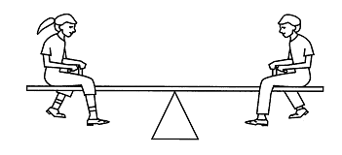
See Saw Method
A + B ↔ C + D
Original Equilibrium
Stress = Add more
A to the beaker
Release
Shift to Remove A
New Equilibrium
Final Change

Slide 10
Example:
A + B ↔ C + D
Stress Applied | Direction Reaction Shifts | [A] | [B] | [C] | [D]
Add A
Example:
A + B ↔ C + D
Stress Applied | Direction Reaction Shifts | [A] | [B] | [C] | [D]
Add D

Slide 11
Remove Reactant or Product
Same principle as adding (ie nothing new)…
Example:
HCl _{(aq)} + NaOH _{(aq)} ↔ NaCl (aq) + H₂O (l)
Stress Applied | Direction Reaction Shifts | [HCl] | [NaOH] | [NaCl] | [H₂O]
Remove NaCl
Remove NaOH

Slide 12
Stress = Temperature
Treat changes in temperature/energy just like a R or P (ie nothing new)…
Endothermic = Energy is added to a reaction
(ie its on the R side)
Exothermic = Energy is release in a reaction
(ie its on the P side)
HEAT + A + B ↔ C + D
A + B ↔ C + D + HEAT

Slide 13
HCl _{(aq)} + NaOH _{(aq)} ↔ NaCl (aq) + H₂O (l) + Heat
Stress Applied | Direction Reaction Shifts | [HCl] | [NaOH] | [NaCl] | [H₂O]
Increase Temp.
Decrease Temp

Slide 14
Review Ch. 12!
Changes in Pressure and Volume
Pressure and Volume are Inversely Proportional (IP)
Only applies to GASES
Stress = Increase Volume
Stress = Decrease Pressure
Vol = 1 Liter
Vol = 2 Liter
[Gas] = 5 M
[Gas] = 2.5 M
Increase in Volume is like a Decrease in Concentration of Gas
Decrease in Pressure is like a Decrease in Concentration of Gas
Release = make more Gas

Slide 15
2 NO₂ _{(g)} ↔ 1 N₂O₄ _{(g)}
Example:
2 mols Gas ↔ 1 mol Gas
Stress Applied | Direction Reaction Shifts | [NO₂] | [N₂O₄]
Increase Vol.
Decrease Vol.

Slide 16
3 A _{(g)} + B ↔ 2 C _{(g)} + 1 D _{(g)}
Example:
3 mols Gas ↔ 3 mols Gas
Stress Applied | Direction Reaction Shifts | [A] | [B] | [C] | [D]
Increase Vol.
Increase Pres.

Slide 17
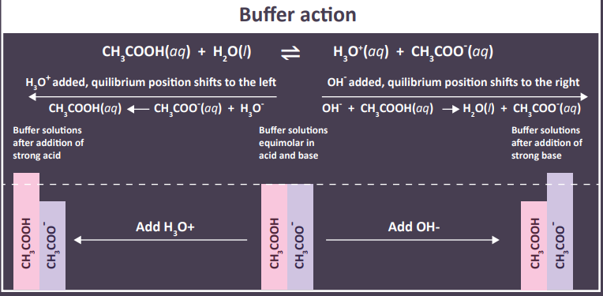
Buffers are an Equilibrium System

Slide 18
Part II
Increasing the Rate of Reactions

Slide 19
Review Ch. 4
Reaction Rates
Reactants must be in Proximity (ie. Collide)
Reactants must have enough Energy to react
Draw an Energy Diagram for an Exothermic Reaction

Slide 20
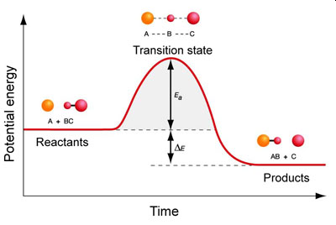
A Prettier Picture
TS
Activation Energy (EA or E_{A})
Energy Change in Reaction
A + B → C + D + Energy
Exothermic Reaction

Slide 21
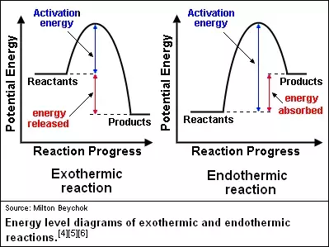
Exothermic vs Endothermic

Slide 22
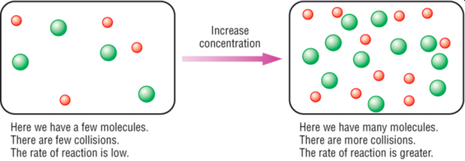
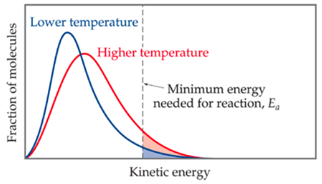
Increasing the Rate
of a Reactions
1
More collisions = more reactions
Increase [R] and [P]
Increase the Temperature
Add a Catalyst
Nature of the reactants (s) vs (aq)
2
Increasing Temperature = More molecule have Energy to React (E_{A})

Slide 23
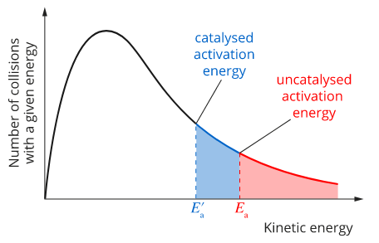
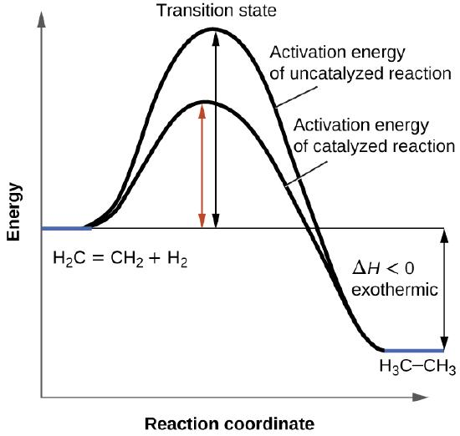
Catalysts
Lower the Activation Energy (EA or E_{A})
New reaction mechanism
Increase the rate of a reaction
Have NO effect on Equilibrium
3
Activation Energy (AE)
(AE)
Catalyzed Activation Energy (CAE)
(CAE)
Change in Energy

Slide 24
4
State of Reactants
Molecules must interact to react
Similar to Surface Area (SA) or Particle Size (PS) for dissolving
Solids = small surface area
Aqueous = large surface area
Reactivity of Ions
Solids = ionic bonds
Aqueous = bonds already broken
A⁺
B⁻
C⁺
D⁻
+
(aq) = dissolved in water
form individual ions
B⁻
A⁺
B⁻
VS
D⁻
D⁻
(s) = solids
AB
AB
CD
A⁺
C⁺
AB
CD
CD
C⁺

