Slide 1
CHE 101 Fall 2021
Lecture 10b – Acids and Bases Part 2
Overview/Topics
Mathematical Definition of Acid/Base
Concentration [ ]
pH Scale
Buffers
Titrations (Review of 6d)
Skills to Master
HW 10 b
Read
Chapter 15.8-15.15

Slide 2
[ ] = concentration
Acidic, Basic and Neutral Solutions
Acid – dissociates to produce excess H⁺ ions in water
Base – dissociates to produce excess OH⁻ ions in water
1 M
1 M
1 x 10⁻⁷ M
1 x 10⁻⁷ M
New Definitions
Acid: [H⁺] > [OH⁻] or [H⁺] > 1 x 10⁻⁷ M
Neutral: [H⁺] = [OH⁻] or [H⁺] = 1 x 10⁻⁷ M
Base: [H⁺] < [OH⁻] or [H⁺] < 1 x 10⁻⁷ M
In 1 billion water molecules
You will have 1 H⁺ and 1 OH⁻

Slide 3
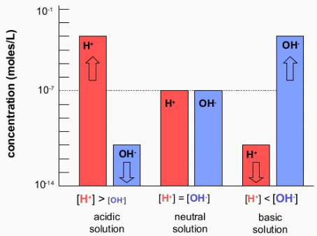
Concentration Scale
[ ] = concentration
Acid: [H⁺] > [OH⁻] or [H⁺] > 1 x 10⁻⁷ M
Neutral: [H⁺] = [OH⁻] or [H⁺] = 1 x 10⁻⁷ M
Base: [H⁺] < [OH⁻] or [H⁺] < 1 x 10⁻⁷ M
Acidic
Basic
Neutral
[H⁺] > 1 x 10⁻⁷ M
[H⁺] = 1 x 10⁻⁷ M
[H⁺] < 1 x 10⁻⁷ M

Slide 4
pH Scale
Calculator
Huge range of value - [H⁺] can go from 10¹-10⁻¹⁴ M
People don’t like M
Convenience (1-14 is easier)
10^{x}
log
pH = - log [H⁺]
[H⁺]= 10^{-pH}
[H⁺] > 1 x 10⁻⁷ M
[H⁺] = 1 x 10⁻⁷ M
[H⁺] < 1 x 10⁻⁷ M
Acidic
Neutral
Basic

Slide 5
pH = - log [H⁺]
SF and Log Scales
[H⁺]= 10^{-pH}
# in front is NOT as SF
Only numbers after . Are SF
Example
pH = 5.25
Example
3 SF
2 SF
Convert [H⁺] = 8.65 x 10⁻⁹ M to pH
Not a SF
[H⁺] = 5.6 x 10⁻⁶ M
pH = 8.063
2 SF
3 SF
Not a SF

Slide 6
You Try It:
Convert pH = 9.25 to [H⁺]
Is the solution A/B/N?
Convert [H⁺] = 4.56 x 10⁻⁵ M to pH
Is the solution A/B/N?

Slide 7
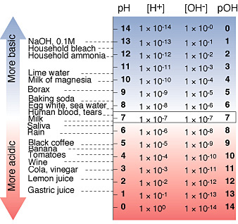
[OH]- and pOH Scales
Same as [H⁺] and pH scales
Reversed definitions of Acid/Base/Neutral

Slide 8
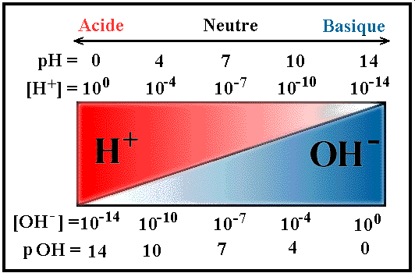
Summary
 | Acidic | Neutral | Basic
[H⁺] | > 10⁻⁷ M | = 10⁻⁷ M | < 10⁻⁷ M
pH | < 7 | = 7 | > 7
[OH⁻] | < 10⁻⁷ M | = 10⁻⁷ M | > 10⁻⁷ M
pOH | > 7 | =7 | < 7
pH to [Conc]
[Conc] to pH
[H⁺] = 10^{-pH}
pH = - log [H⁺]
[OH⁻] = 10^{-pOH}
pOH = - log [OH⁻]
[H⁺] [OH⁻] = 10⁻¹⁴ M
pH + pOH = 14
Double Check
pH = 1.50 then [H+] = 3.2 x 10⁻² M
pH = 7 then [H+] = 1 x 10⁻¹⁴ M
pH = 10.805 then [H+] = 1.57 x 10⁻¹¹ M
SF’s

Slide 9
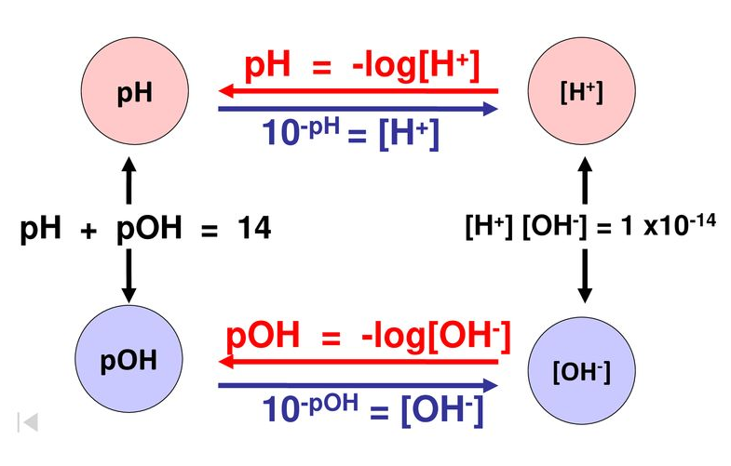
Acid/Base Calculations

Slide 10
Acid/Base Square
pOH = -log[OH⁻]
[OH⁻]
[OH⁻] = 10^{-pH}
pOH
10⁻¹⁴ M
Basic
14
10⁻⁷ M
Neutral
7
[H⁺][OH⁻] = 10⁻¹⁴ M
pH + pOH = 14
10⁻¹ M
Acidic
1
[H⁺]
pH = -log[H⁺]
pH
[H⁺] = 10^{-pH}

Slide 11
You Try It:
Convert pOH = 4.55 to [OH⁻]
Is the solution A/B/N?
Convert [OH⁻] = 1.25 x 10⁻¹² M to pOH
Is the solution A/B/N?
Convert pOH = 8.25 to [H⁺]
Is the solution A/B/N?
Convert [OH⁻] = 2.9 x 10⁻⁹ M to pH
Is the solution A/B/N?

Slide 12
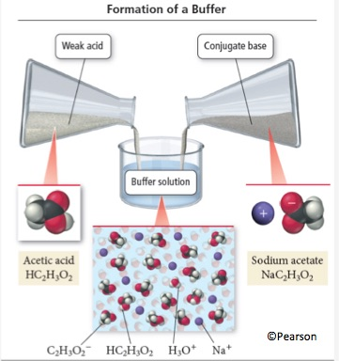
Buffers
Solutions that are resistant to changes in pH
wa + salt of conjugate base
wb + salt of conjugate acid
Weak Acid
Salt of Weak Acid
Replace H with Metal Ion

Slide 13
How Buffers Work
Acid + Base = Salt + Water
HC₂H₃O₂ + NaOH → NaC₂H₃O₂ + H₂O
Salt CB + Acid = Weak Acid + Salt
NaC₂H₃O₂ + HCl → HC₂H₃O₂ + NaCl

Slide 14
You Try It:
Which of the following is a Buffer Systems?
H₂SO₄ / Na₂SO₄
HF / KF
NH₃ / NH₄Cl
NaOH / KOH
HC₂H₂O₂ / HF
You Try It:
To make a buffer system you could add which of the following to HNO₂:
HNO₃
NaNO₂
NaOH
Mg(NO₂)₂
KC₂H₃O₂

Slide 15
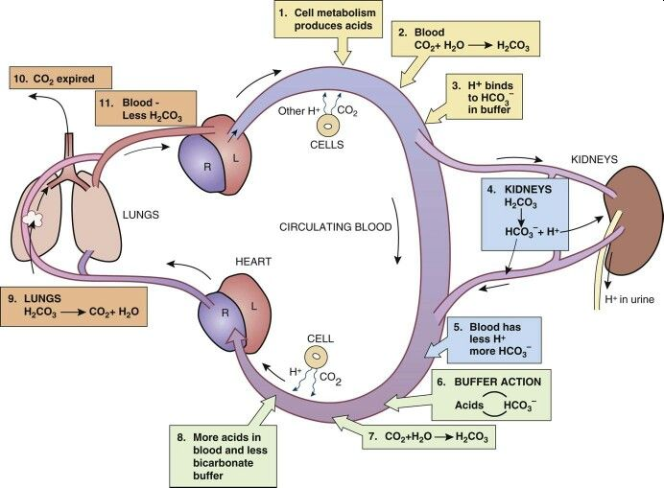
Important Buffer Systems
Not on CHE 101 Exam
BIO 201/202?

Slide 16
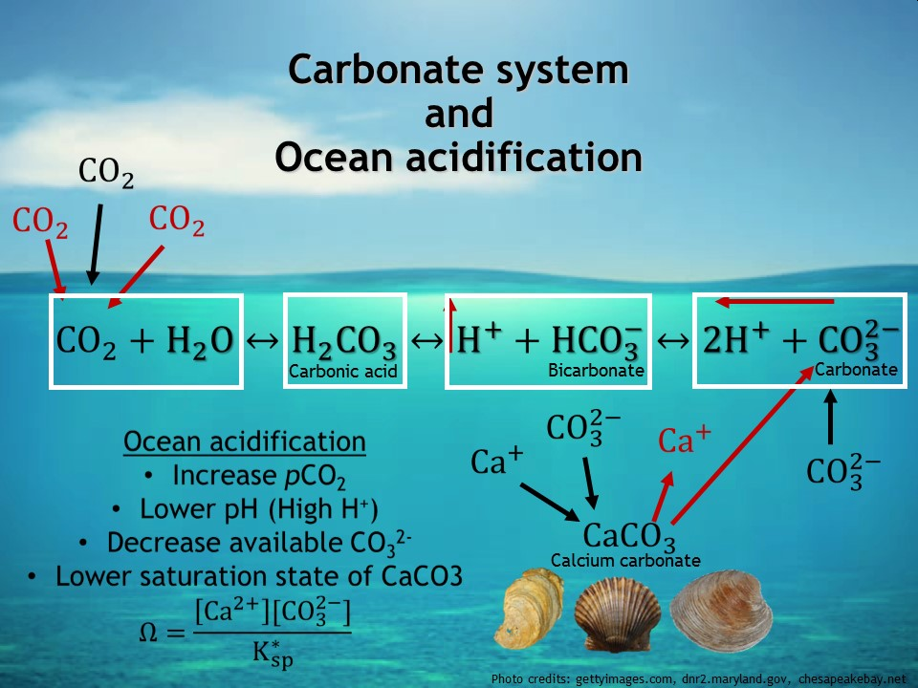
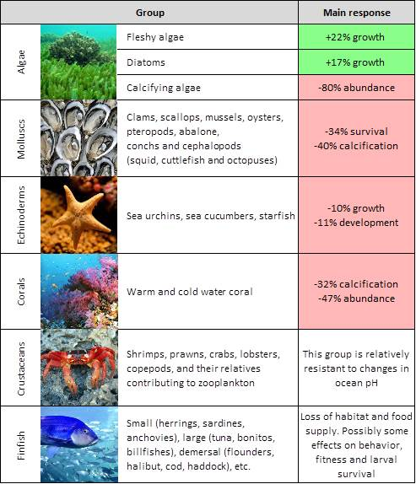
Ocean Acidification
Not on CHE 101 Exam
ENV 101?

Slide 17
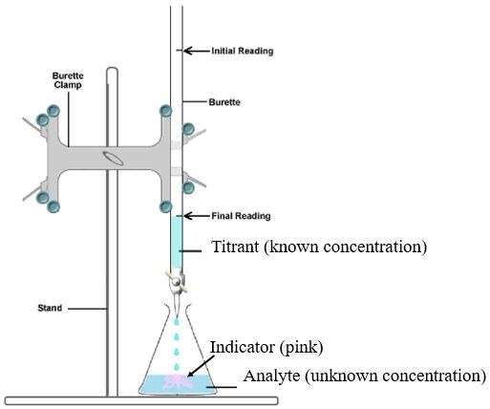
Review 6d HW!
Titration
“Neutralization”
Method to determine the concentration or amount of an unknown substance by reacting it with a known substance
A + B → C + D
Conc. (M)
Vol. (V)
Conc. (M)
Vol. (V)
Known Concentration
Known Volume
Given any 3 value’s can solve for the missing value.
Indicator – Changes color when:
[A] = [B]
Unknown Concentration
Known Volume or Mass

Slide 18
Tools for Solving Problems II
2 Types of Titration Problems
Review 6d HW!
A B
A B
mL
M
x
?
mL
M
x
x
x
x
x
?
Start:
mL A
mL B
$$\frac{mL A}{mL B}$$
$$\frac{mol B}{L B}$$
Start:
MW
MW
mol/mol
Grams A
Mol A
Mol B
Grams B
Mol to Mol Ratio
from Balanced Eqn
Molecular Weight
g/mol
Molecular Weight
g/mol
M
M
mL A
mL B

Slide 19
You Try It:
_1_ H₂SO₄ (aq) + _2_ KOH (aq) → _1_ K₂SO₄ (aq) + _2_ H₂O + Heat
It required 117.0 mL of 2.50 M H₂SO₄ to neutralize 15.0 mL of an unknown concentration of KOH . What is the Molarity of the KOH solution?

Slide 20
You Try It:
_3_ HCl (aq) + _1_ Al(OH)₃ (aq) → _1_ AlCl₃ (aq) + _3_ H₂O + Heat
How many mL of 1.25 M Al(OH)₃ are required to titrate 95.0 mL of 0.75 M HCl?

