Slide 1
CHE 101 Fall 2021
Lecture 10a – Acids, Base, Reactions and Electrolytes
Overview/Topics
Definitions of A/B
Arrhenius
Bronsted-Lowry
Lewis
Conjugate Acid/Base Pairs
H⁺ , Hydronium ion, Bare Proton and H₃O⁺
Review of Reactions (Ch. 8)
SE, WE, NE
Molecular, Total Ionic and Net Ionic Reactions
Skills to Master
HW 10 a
Read
Chapter 15.1-15.7

Slide 2
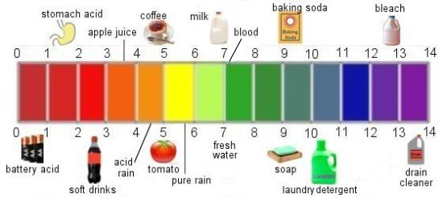
Review Ch. 4
Acids
Bases
H
Anion or Polyatomic
Metal Atom
OH
Naming - Memorize (10)
Naming – Normal Ionic Rules
Review Ch. 6
General Properties
Taste Bitter
Slippery to touch
Litmus: R → B
General Properties
Taste Sour
Litmus: B → R

Slide 3
(1859-1927)
Also discovered ion’s
Named Cation/Anion
Arrhenius Definition
Acid – dissociates to produce excess H⁺ ions in water
Base – dissociates to produce excess OH⁻ ions in water
HCl (aq) + H₂O → H₃O⁺ (aq) + Cl⁻ (aq)
Limitations
must be in water
Miss’s some bases

Slide 4
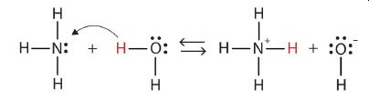
Bronsted-Lowry Definition
(1923)
Acid – Proton (H⁺) donor
Base – Proton (H⁺) acceptor
HCl (aq) + H₂O → H₃O⁺ (aq) + Cl⁻ (aq)
Donor
Acceptor
Acid - same definition
Base – broader definition
A base without OH!
Acceptor
Donor

Slide 5
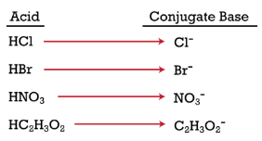
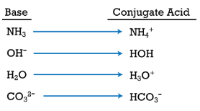
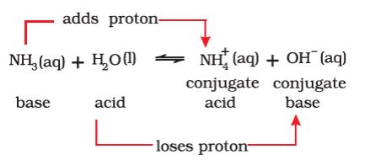
Conjugate Acids/Bases

Slide 6
Water is both an Acid and a Base

Slide 7
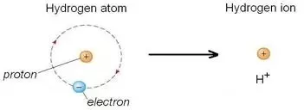
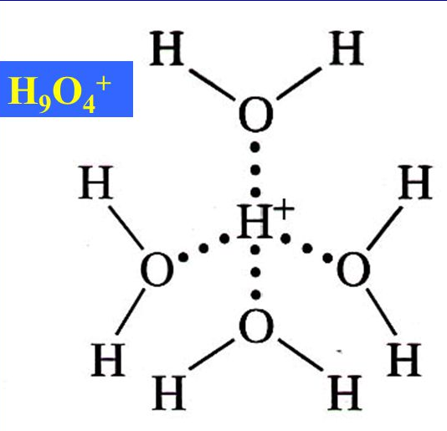
Different Ways to Write Acid Reactions
Hydrogen Ion
Bare Proton
HCl (aq) + H₂O → H₃O⁺ (aq) + Cl⁻ (aq)
Hydronium Ion
Don’t learn this
Its all the same:
H⁺, Proton
Hydronium Ion

Slide 8
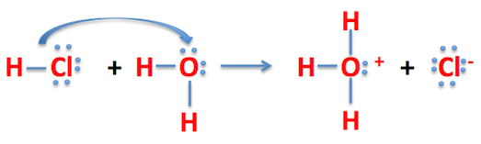
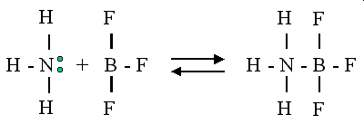
Lewis Definition
Acid – electron pair acceptor
Base – electron pair donor
Even more compounds can be Acids or Bases
Acid – needs electrons
Base – unshared pair of electrons

Slide 9
Summary
Acid – dissociates to produce excess H⁺ ions in water
Base – dissociates to produce excess OH⁻ ions in water
Expands dfn. of Base
Acid – Proton (H⁺) donor
Base – Proton (H⁺) acceptor
Expands dfn. of A and
Acid – electron pair acceptor
Base – electron pair donor
H₃O⁺
Its all the same:
H⁺, Bare Proton, H₃O⁺
Hydronium Ion

Slide 10
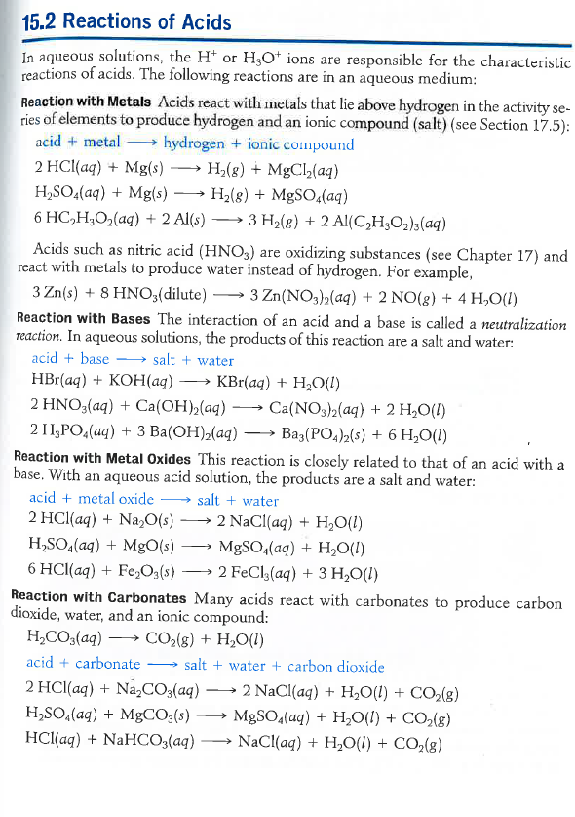
Reactions of Acids and Bases
Review Ch. 6
Single Displacement (SD)
Acid Base (AB)
“Double Displacement“ (DD)
Decomposition (DD)

Slide 11
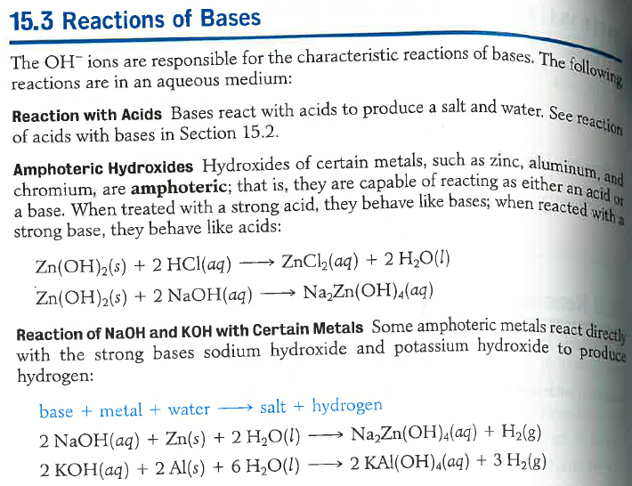
Reactions of Acids and Bases
Review Ch. 6
Acid Base (AB)
Ignore!

Slide 12
Aqueous Solutions
Strong Electrolytes (SE)
Weak Electrolytes (WE)
Non-Electrolytes (NE)
Dissociate 100% into ions
Conduct electricity
SA, SB, Ionic (aq)
Dissociate < 10% into ions
May conduct electricity
wa, wb
Do not dissociate
Do not conduct electricity
Molecular (nm/nm) + Ionic (s)
NaCl (s) → Na⁺ (aq) + Cl⁻ (aq)
HF (s) ↔ H⁺ (aq) + F⁻ (aq)
C₆H₁₂O₆ (s) → C₆H₁₂O₆ (aq)
0% 100%
90% 10%
0% 100%

Slide 13
Jay’s Awesome Drawing - NaCl

Slide 14
Jay’s Awesome Drawing - HF

Slide 15
Jay’s Awesome Drawing – C₆H₁₂O₆

Slide 16
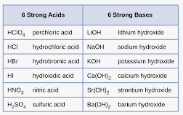
Strong Electrolytes (SE)
Non-Electrolytes (NE)
Dissociate 100% into ions
Conduct electricity
SA, SB, Ionic (aq)
Do not dissociate
Do not conduct electricity
Molecular (nm/nm) + Ionic (s)
Weak Electrolytes (WE)
Dissociate < 10% into ions
May conduct electricity
wa, wb
Not a SA or SB

Slide 17
Writing Chemical Equations
Molecular Equation
“Normal” equation
All species written as molecules
_1_ Pb(NO₃)₂ (aq) + _2_ NaOH (aq) → _1_ Pb(OH)₂ (s) + _2_ NaNO₃ (aq)
Ionic Equation
“More realistic” equation
SE written as (aq)
WE/NE written as normal
Net Ionic Equation
“Focused” equation
Only include molecules which change
Eliminate “spectator” ions (d/n change)

Slide 18
Jay’s Awesome Drawings
_1_ Pb(NO₃)₂ (aq) + _2_ NaOH (aq) → _1_ Pb(OH)₂ (s) + _2_ NaNO₃ (aq)

Slide 19
You Try It
_2_ KOH (aq) + _1_ H₂SO₄ (aq) → _1_ K₂SO₄ (aq) + _2_ H₂O (l)

Slide 20
You Try It
_1_ Zn (s) + _2_ HCl (aq) → _1_ ZnCl₂ (aq) + _1_ H₂ (g)

Slide 21
You Try It
_2_ NH₄OH (aq) + _1_ H₂SO₄ (aq) → _2_ (NH₄)₂SO₄ (aq) + _2_ H₂O (l)

