Slide 1
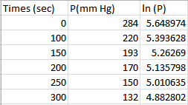
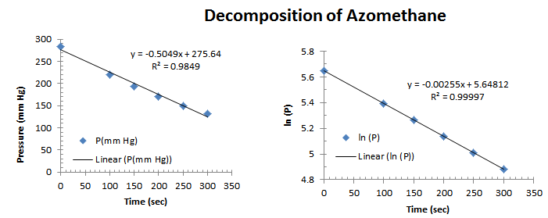
Time (sec) | [NO2] (M) | ln (NO2) | 1/[NO2]
0 | 0.01 | -4.60517 | 100
50 | 0.00787 | -4.844697 | 127.0648
100 | 0.00649 | -5.037493 | 154.0832
200 | 0.00481 | -5.337058 | 207.9002
300 | 0.0038 | -5.572754 | 263.1579

Slide 3
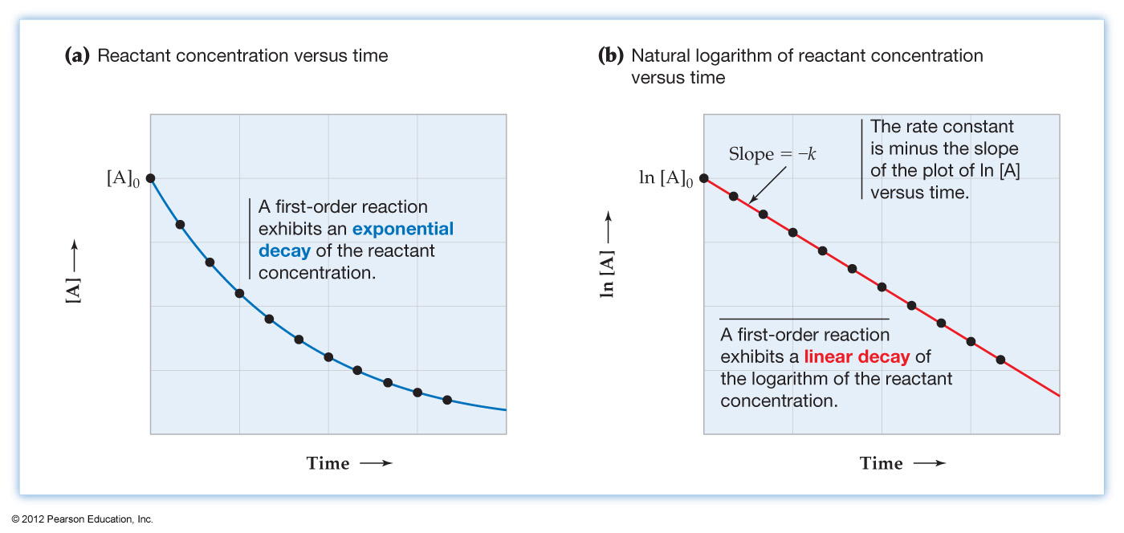
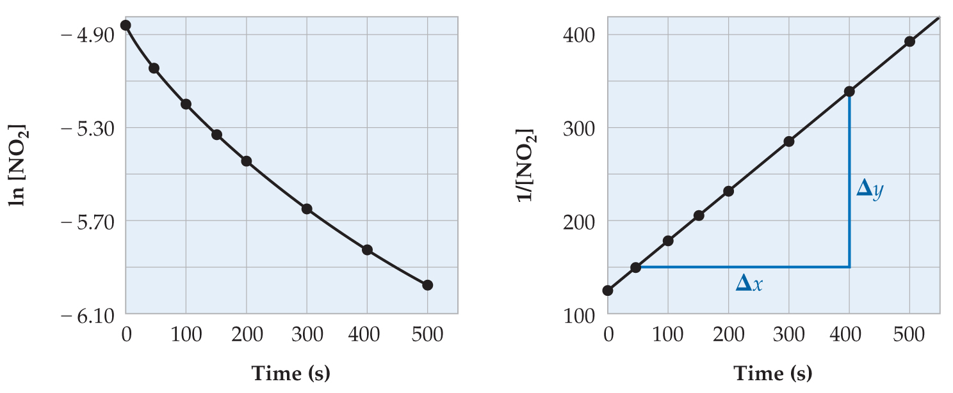
1st Order Reaction
2nd Order Reaction

Slide 5
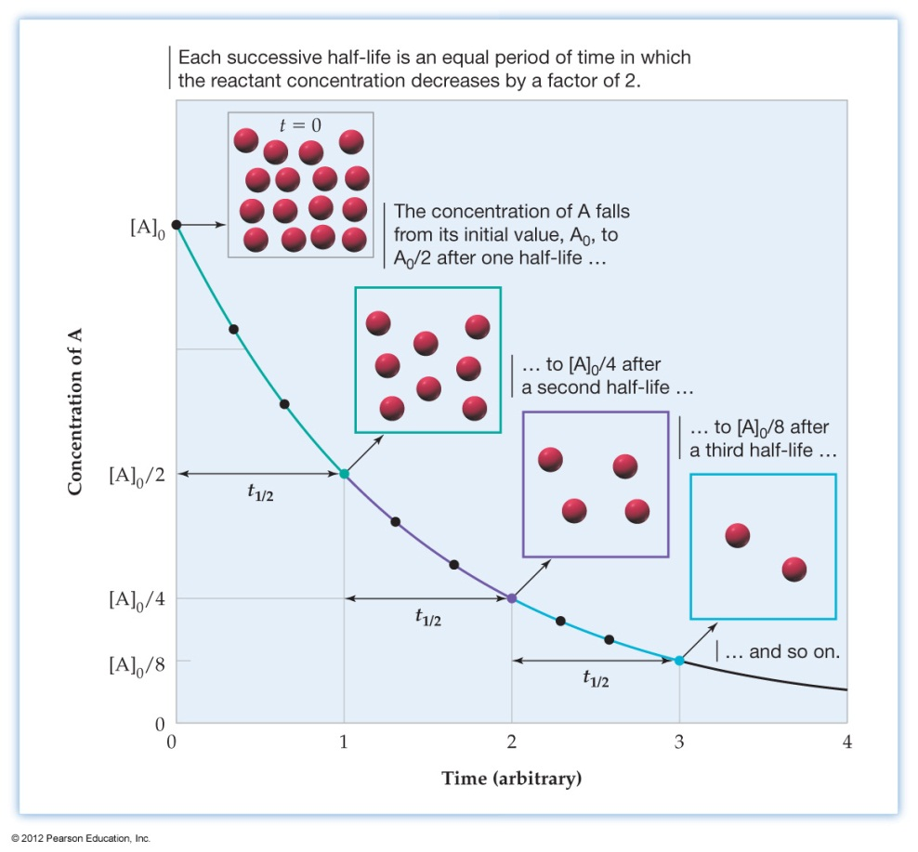
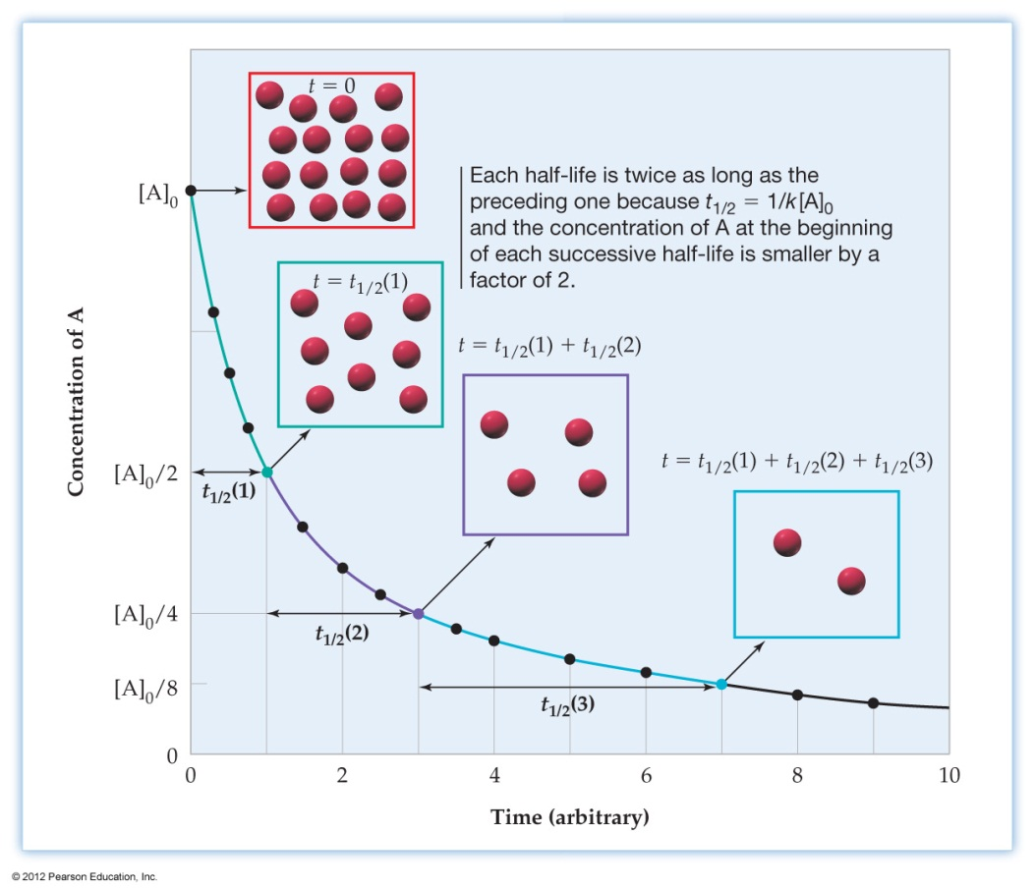
Half-Life
1st Order Reaction
0.693
t_{1/2} =
k
2nd Order Reaction
1
t_{1/2}
=
k[A]₀

Slide 7
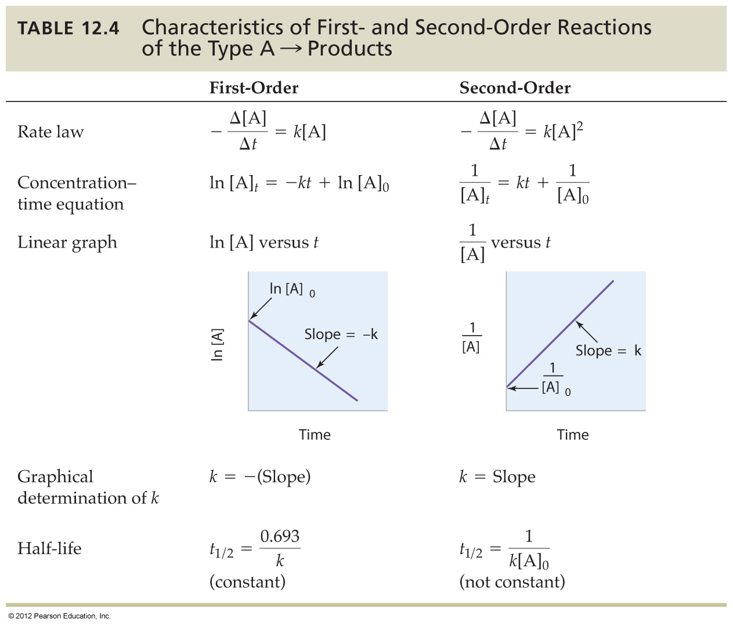

Slide 9
