Slide 1
Lipids - Definition

Slide 2
Definition:
Water insoluble
No common structure – (though generally large R-groups)

Slide 3
Water Solubility
(Hydrophilic)

Slide 4
What makes molecules water soluble (hydrophilic)?
Like dissolves like
Small
Similar IMF’s – Polar/H-bonds
Functional Groups that are generally water soluble:
Alcohols
Amines
Amides
Carboxylic
Acids

Slide 5
Water Insoluble
(Hydrophobic)

Slide 6
What makes molecules water insoluble (hydrophobic)?
Large molecules (R-groups)
Different IMF’s – Nonpolar
Functional Groups that are generally water insoluble:
Alkane/ene/yne
Ether
Ester

Slide 7
Classification of
Lipids

Slide 8
Fatty Acids
Giant CA
Lipids
Simple Lipids
Waxes
Giant Esters
Fats and Oils
Esters of Glycerol + 3 FA
Glycerol + Phosphoric Acid + 2 FA + nitrogen/base
Phospholipids
Compound
Lipids
Sphingolipids
Sphingosine + Phosphoric Acid + 1 FA + nitrogen/base
Glycolipids
Sphingosine + 1 FA + carbohydrate
Steroids
Cholesterol
Misc. Steroids
Miscellaneous
Vitamins
Lipoprotiens

Slide 9
Fatty Acids

Slide 10
Fatty Acids:
Giant Carboxylic Acids
Straight (unbranched) chains
Even number of carbons
Saturated vs. Unsaturated
Cis vs. Trans isomers
Essential FA
ω-3 vs. ω-6
Eicosands –
arachidonic acid, linolenic acid, linoleic acid
thromboxane, prostaglandin, prostacyclin, leukotriene

Slide 11
Saturated
vs.
Unsaturated

Slide 12
Saturated FA
Unsaturated FA
Physical
No C=C
Mostly animals
(and higher plant cells)
Higher MP (solids)
Long shelf life
Linear → LDF →Pack better
Replace cholesterol in LDL/HDL
Only used for Energy
Physical
Contain C=C
Plants
Lower MP (liquids)
Spoil quickly
Cis/Trans Isomers
Biological
Excess → atherosclerosis
heart diseases
Increase LDL (bad)
Decrease HDL (good)
Can block arteries easier
Biological
Good (better than Sat.)
Increase HDL (good)
Decrease LDL (bad)
Bonus Reaction: Use of Br₂ to detect presence.

Slide 13
Saturated
vs.
Unsaturated

Slide 14
 | Saturated Fats | Unsaturated Fats
Recommended consumption: | Not more than 10% of total calories per day. | Not more than 30% of total calories per day
Health Effect: | Excessive consumption is not good because of their association with atherosclerosis and heart diseases. | Unsaturated fats are considered good to eat if you are watching your cholesterol.
Life: | These are long lasting and do not get spoiled quickly | These get spoiled quickly
Commonly found in: | Butter, coconut oil, whole milk, meat,peanut butter,margarine,cheese,vegetable oil or fish oil | Avocado, soybean oil, canola oil, olive oil
Cholesterol: | Saturated fats increase LDL (badcholesterol) and decrease the HDL | Unsaturated fats increase high-density lipoprotein ( HDL or good cholesterol) and decrease LDL (bad cholesterol)
Melting Point: | High | Low
Physical state at room temperature: | Solid | Liquid
Type of bonds: | Consist of SINGLE bond | Consist of at least 1 DOUBLE bond

Slide 15
Cis vs. Trans
Isomers

Slide 16
Cis-Isomer
Trans-Isomer
Physical
Contain C=C
Naturally occurring
Physical
Contain C=C
Rare in a nature
Man made through
Hydrogenation Reaction
Linear → Packs tightly → High MP
Biological
GOOD
Decrease LDL (bad)
Increase HDL (good)
Biological
BAD
Increase LDL (bad)
Decrease HDL (good)
Increase risk of Heart Attack

Slide 17
ω-3 vs. ω-6
Fatty Acids

Slide 18
Greek letter Omega (ω) is the last letter in the Greek alphabet. It is used by biologist
(counting from the wrong end of the molecule!) to indicate the position of the first
C=C in an unsaturated fat.
ω-6 Fatty Acids
ω-3 Fatty Acids
Biological
GOOD
Precursor to molecules that produce
useful (less harmful) effects
Ex: Linolenic acid
Biological
BAD
Precursor to molecules that produce
harmful (exaggerated) effects
Ex: Arachidonic acid → Trigger for
Heart Attacks

Slide 19
Eicosanoids

Slide 20
Eicosanoids:
Example of FA Biological Pathway
Parent molecule Daughter molecules
Local Hormones – short lived
Coordinate immune system response, blood clotting
○ attract WBC, vasodilation/restriction, body temperature, mucous etc.
○ Ratio of ω-3 vs. ω-6 ratio important
Drugs – used to control biochemical pathway
○ NSAIDS – inhibit cyclooxygenase (side-effect: stomach ulcers)
○ COX-2 – inhibit cyclooxygenase (side-effect: increased heart attacks)
Enzyme (-ase)
thromboxanes
FA
(arachidonic acid)
cyclooxygenase
prostacyclins
prostaglandins
lipoxygenase
leukotrienes

Slide 21
Biological Pathways

Slide 22
Biological Pathways:
Precursor Molecules
Parent molecule Daughter molecules
Examples:
○ Eicosanoids (FA)
○ Steroids
○ Atherosclerosis
Control mechanisms for biological pathways
Enzyme (-ase)

Slide 23
Fats and Oils
Structure

Slide 24
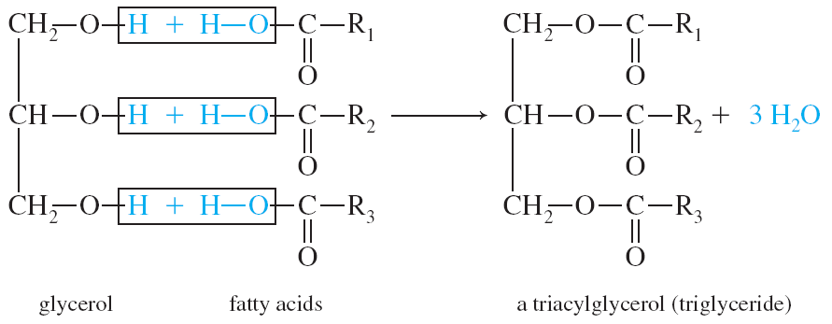
Glycerol
Fatty acid
Fats and Oils:
Glycerol + 3 FA
Giant Esters
Dehydration Reaction
Amide Bonds
Triacylglycerol or Triglycerides
Hydrophobic
Fatty acid
Fatty acid

Slide 25
Fats and Oils
Biological Properties

Slide 26
Fats:
9.5 kcal/g or 40 kJ/g
Average FA is 75% Carbon
More Reduced
Carbohydrates:
4.5 kcal/g or 20 kJ/g
Average FA is 40% Carbon
More oxidized
Ox: -2
Ox: 0
Oxidation Number: Charge an atom would have if it were in an ionic compound
H = +1
O = -2
C = calculate
Ox: -4
Ox: +4

Slide 27
Waxes

Slide 28
Waxes:
Giant Ester (20-30 Carbons)
Very hydrophobic
Used as protective layer on plant leaves, animal feathers, fur, cars, floors

Slide 29
Phospholipids

Slide 30
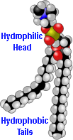
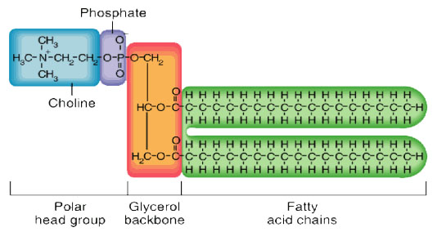
Phospholipids:
Structure:
○ Glycerol
○ 2 - FA
○ 1 - Phosphoric Acid
○ Amino-alcohol
Nerve tissue, brain matter, cell membranes (10-20%)
Used in foods as an emulsifier for chocolates and margarine
Hydrophobic vs. Hydrophilic parts
Formation reaction
Ester bond
Glycerol
Fatty acid
Fatty acid
PO₄
Nitrogen
Base

Slide 31
Sphingolipids

Slide 32
Sphingolipids:
Structure:
○ Sphingosine
○ 1 - FA
○ 1 - Phosphoric Acid
○ Amino-alcohol
Membrane components, nerve sheath
Hydrophobic vs. Hydrophilic parts
Formation reaction
Amide bond
Sphingosine
Fatty acid
PO₄
Nitrogen
Base

Slide 33
Glycolipids

Slide 34
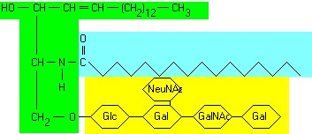
Glycolipids:
Structure:
○ Sphingosine
○ 1 - FA
○ 1 - Phosphoric Acid
○ Carbohydrate
Cerebrosides and gangliosides – cell membranes of nerve and brain tissue
Hydrophobic vs. Hydrophilic parts
Formation reaction
Amide bond
Sphingosine
Fatty acid
PO₄
Carbo-hydrate

Slide 35
Steroids

Slide 36
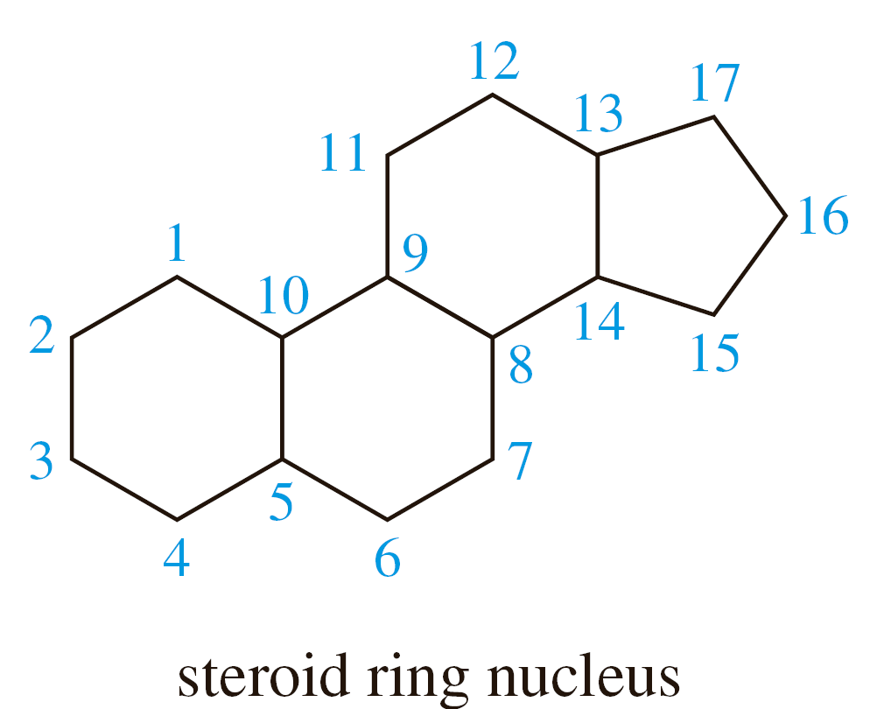
Steroids:
Parent Molecule → Daughter Molecules
Vary widely in function
Cholesterol - membrane component
Bile salts – digestion of fats
Ergosterol → Vitamin D
Digitalis – heart drug
Adrenal cortex hormones – metabolism
Sex hormones – characteristics and reproduction
Figure 28.5

Slide 37
Micelles
and
Liposomes

Slide 38
Micelles:
Formed from FA
Polar head
1 Non-Polar Tail
Single layer
Liposomes:
Formed from phospholipids etc.
Polar head
2 Non-polar tails
Double layer
Nonpolar
Nonpolar
Polar
Polar

Slide 39
Atherosclerosis

Slide 40
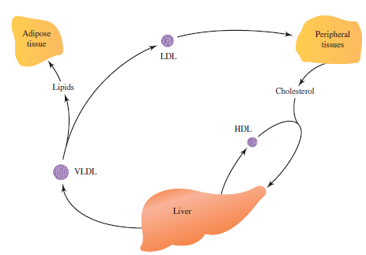
Atherosclerosis:
Metabolic disease → deposits of lipids on artery walls → heart attack
Lipids naturally aggregate (hydrophobic)
Lipids trapped in artery walls (oxidized)
White cells (macrophages) scavenge lipids → bloated
Foam cells are stuck to arteries
Improper transport of lipids
Lipid “cycle”
VLDL = Good – deliver lipids
Adipose = Storage
LDL = BAD
Peripheral = Energy
HDL = GOOD – recycle
Drugs/Treatment
Low cholesterol diet
Decrease Triacylglycerol production
Inhibit metabolic synthesis of cholesterol
Increase excretion
Decrease absorption

Slide 41
Cell Membranes

Slide 42
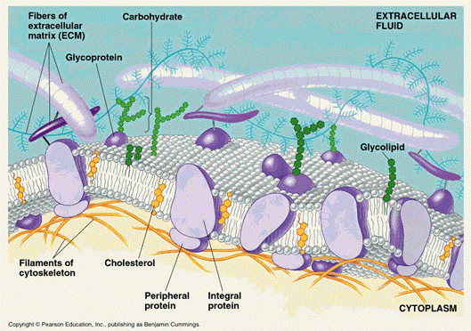

Slide 43
Reaction – Br₂

Slide 44
Reaction: General test for saturation.
C=C react quickly with Br₂
Addition Reaction
Orange → Clear
+ Br₂ → Slow (Requires UV light)
Orange → NR

Slide 45
Reaction -
Hydrogenation

Slide 46
Reaction:
Unsaturated FA → Saturated FA
Addition reaction
H₂

Slide 47
Reaction –
Dehydration

Slide 48
Dehydration reactions are how most molecules in this chapter are formed
Glycerol + 3 FA → Fats and Oils
CA + Alcohol → Waxes
Glycerol + 2 FA + Phosphate + Amino-alcohol → Phospholipid
Etc…

